Slide 1
Roman Clothing

Slide 2
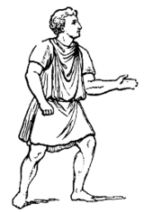
Men
Tunic
knee length garment tied with a belt
Toga
only male citizens could wear the Toga
Long piece of woolen cloth that was worn draped over the left shoulder
Different colors indicated a person’s position in Rome
Tunic

Slide 3
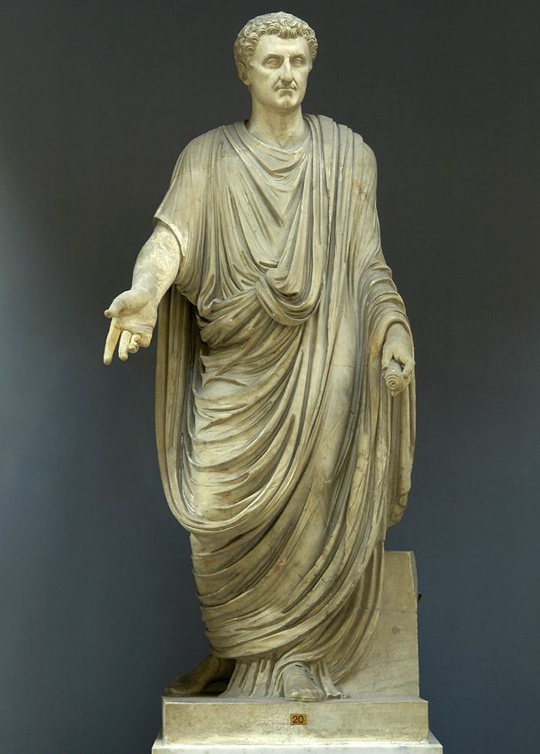
Toga

Slide 4
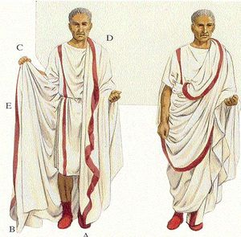
Toga

Slide 5
Types of Toga
toga praetexta
white with purple stripe on shoulder
worn by boys under 16 and magistrates (elected officials)
toga virilis
plain white, worn by men over 16
toga candida
bright white (whitened with chalk)
worn by candidates for office
toga pulla
dark toga worn by men in mourning
toga picta
solid purple
worn by generals during Triumphs and by consuls and emperors

Slide 6
Women’s Clothing
Tunica
longer version of tunic
could go all the way to the floor
Stola
long dress worn by married women
Palla
long shawl
Tunica

Slide 7
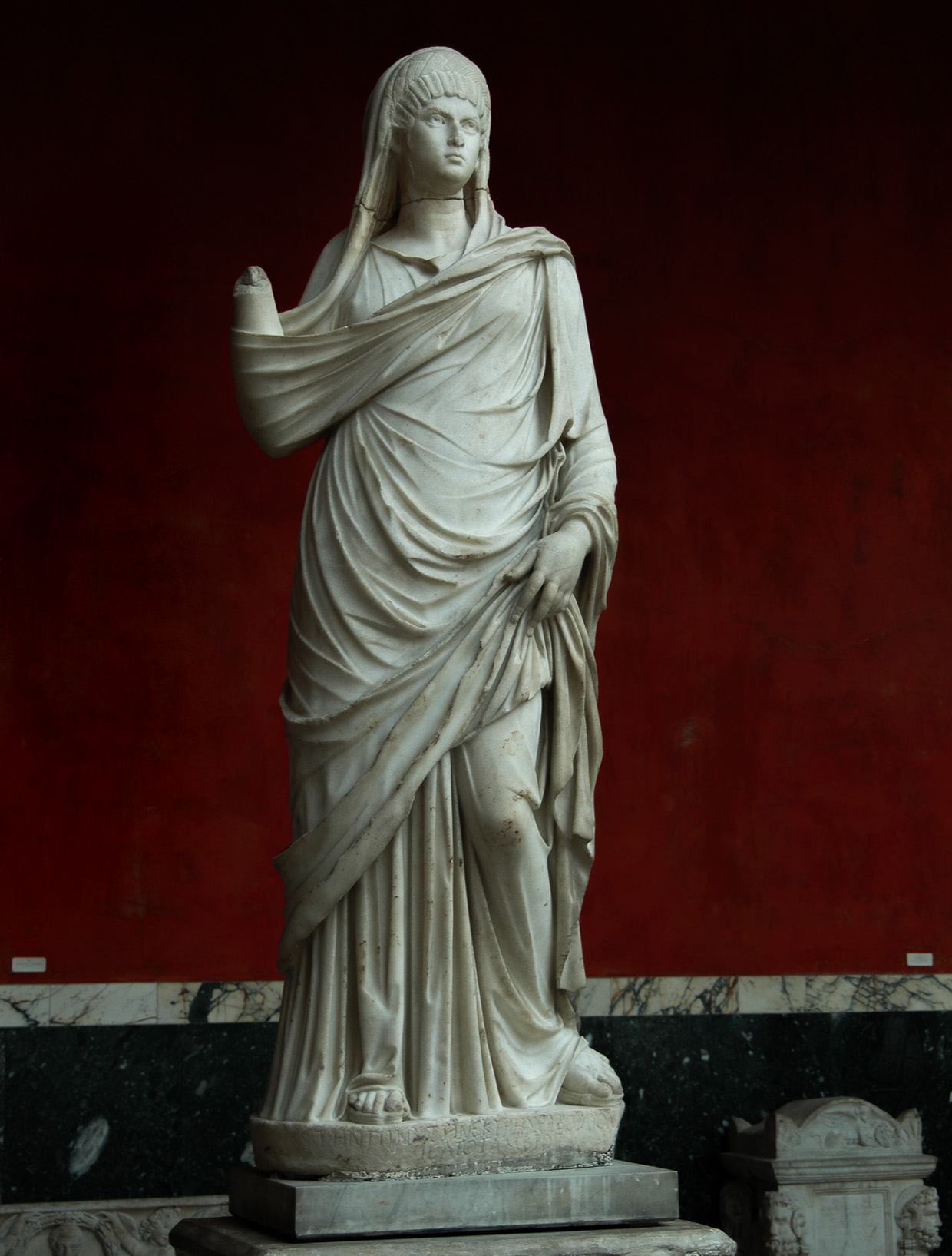
Stola and Palla

Slide 8
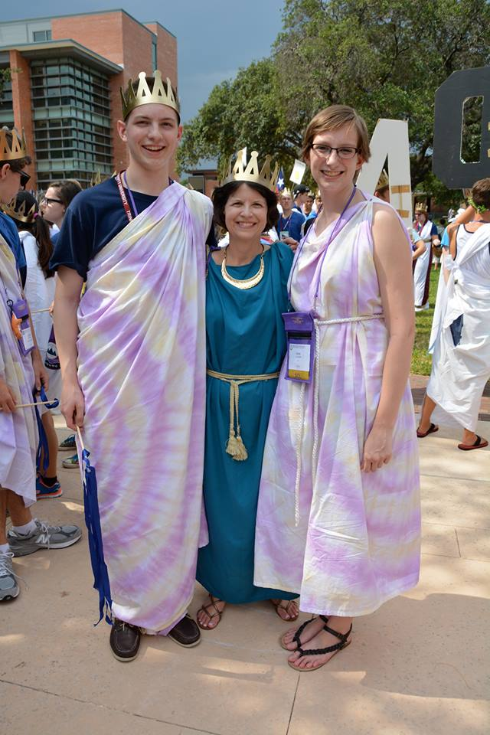

Slide 9
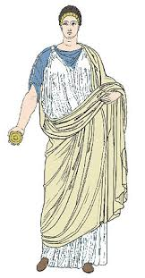
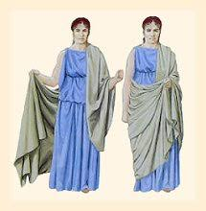

Slide 10
Other Clothing
Underwear
subligaculum: simple loin cloth worn by men and women
Shoes
Calceus: more enclosed shoe
solea: sandal

Slide 11
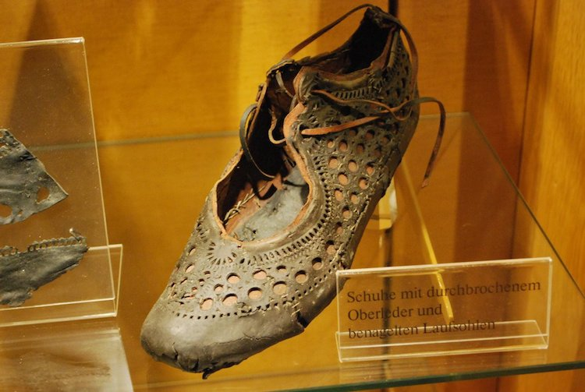
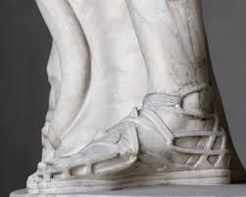
Solea
Calceus

Slide 12
Jewelry
Men
signet ring for marking sealing wax of important documents
Women: made of metal, could have precious stones
earrings: one per ear
rings
bracelets
fibula: pins (think like brooches)
Necklaces

Slide 13
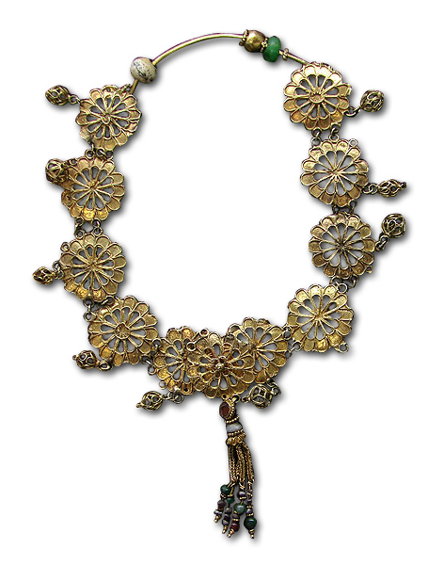

Slide 14
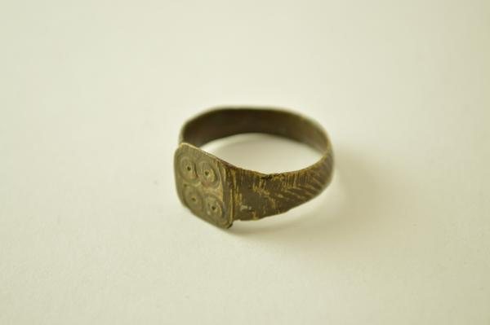

Slide 15
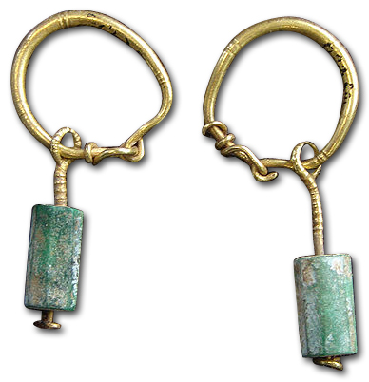
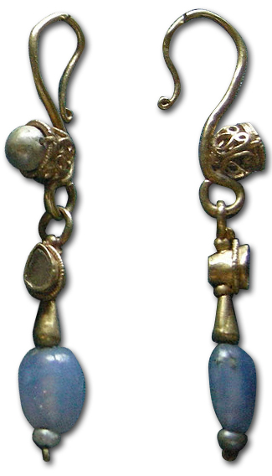

Slide 16
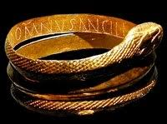
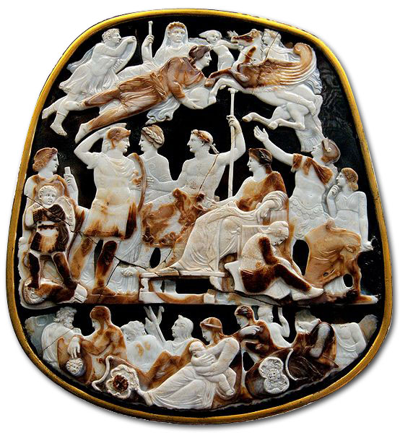

Slide 17
